Slide 1


CS 337E: Design for Global Grand Challenges
09. Medium-fi Prototype #3 and Usability Study
nurturEd
Team Mango
2023 May 31

Slide 2

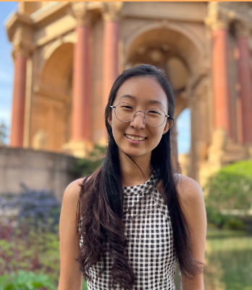
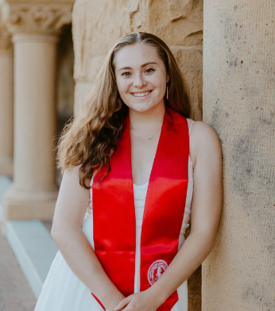
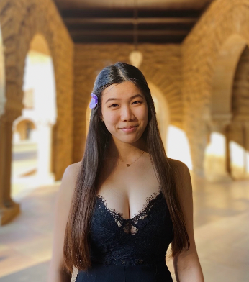
Our Team
Nathan Marks
Christina Kwak
Claire Muscat
Grace Zhang
CS, AI Coterm
Econ, HCI Coterm
CS, HCI Coterm
CS, HCI Coterm

Slide 3
nurturEd
An education expert in your pocket.

Slide 4
Presentation Outline
Design changes from heuristic evaluation
User testing
Results and future plans

Slide 5
Design
Changes

Slide 6
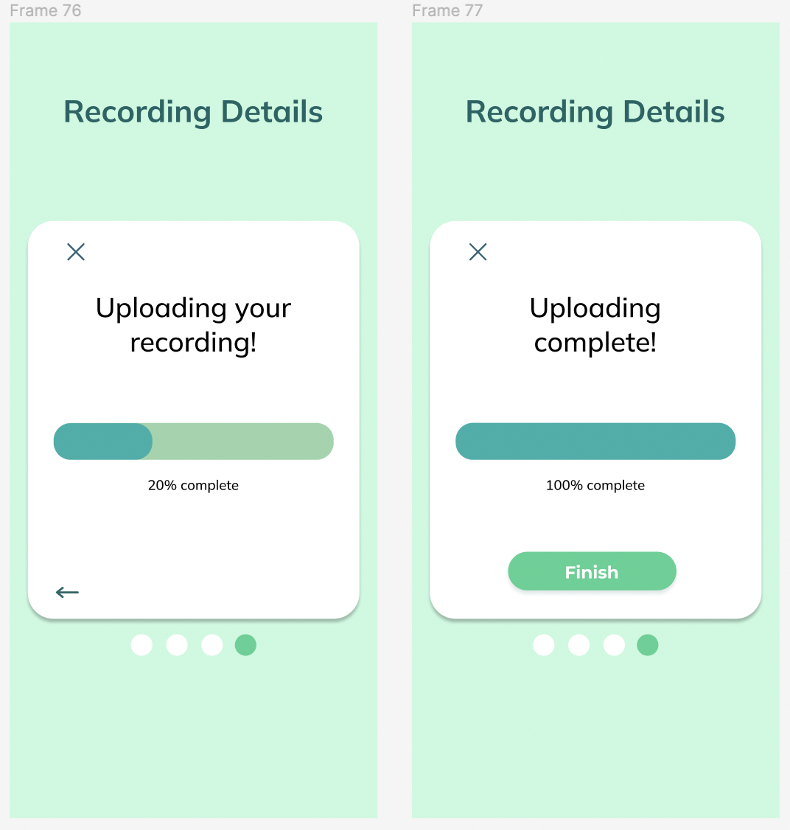
Added a progress bar during lesson transcript upload

Slide 7
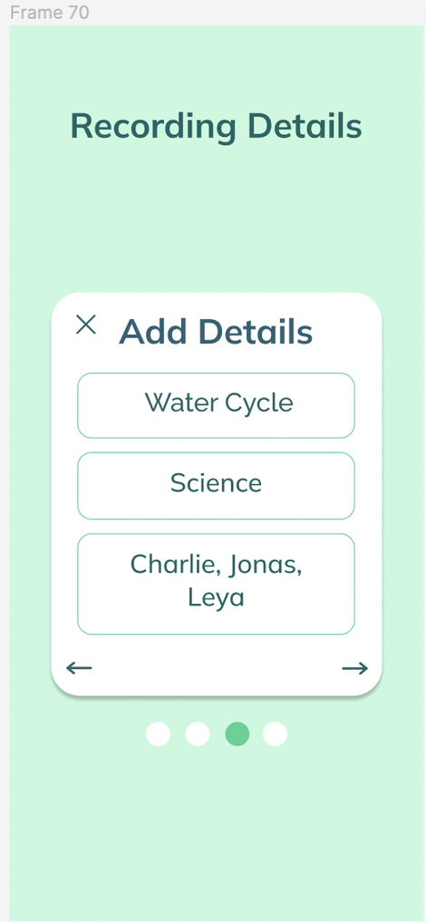
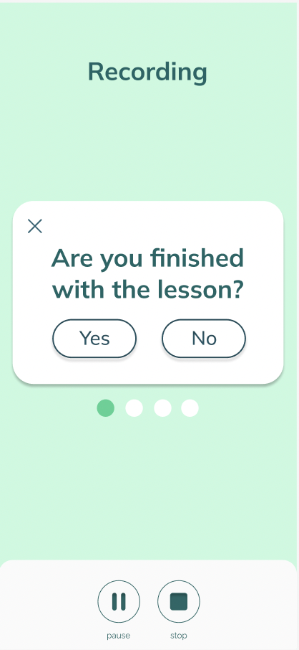

Greater user control and app confirmation

Slide 8
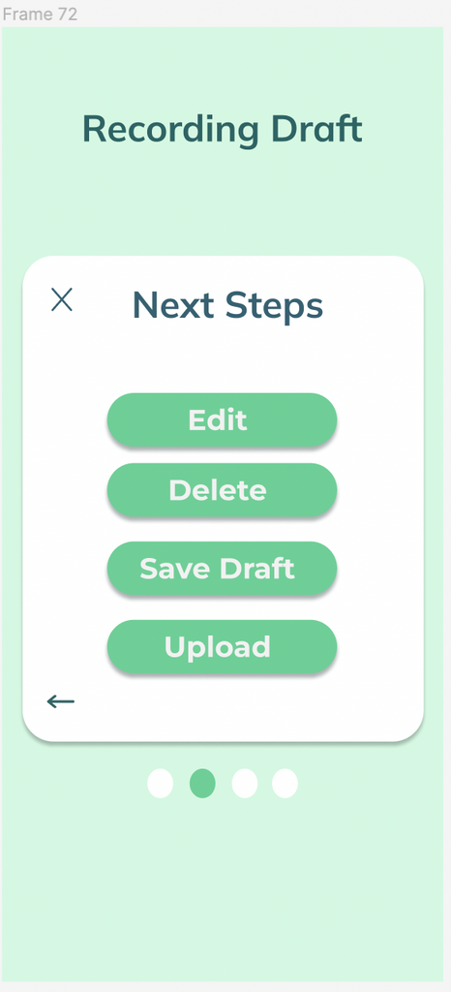
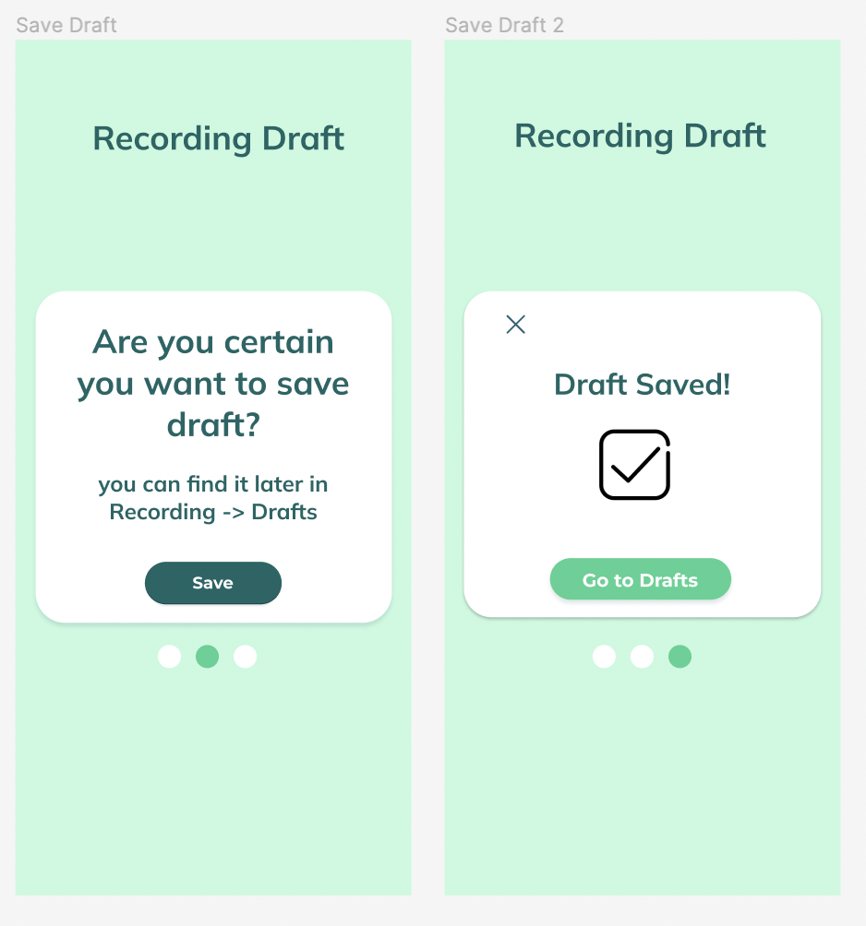

Added feature for saving lesson drafts

Slide 9
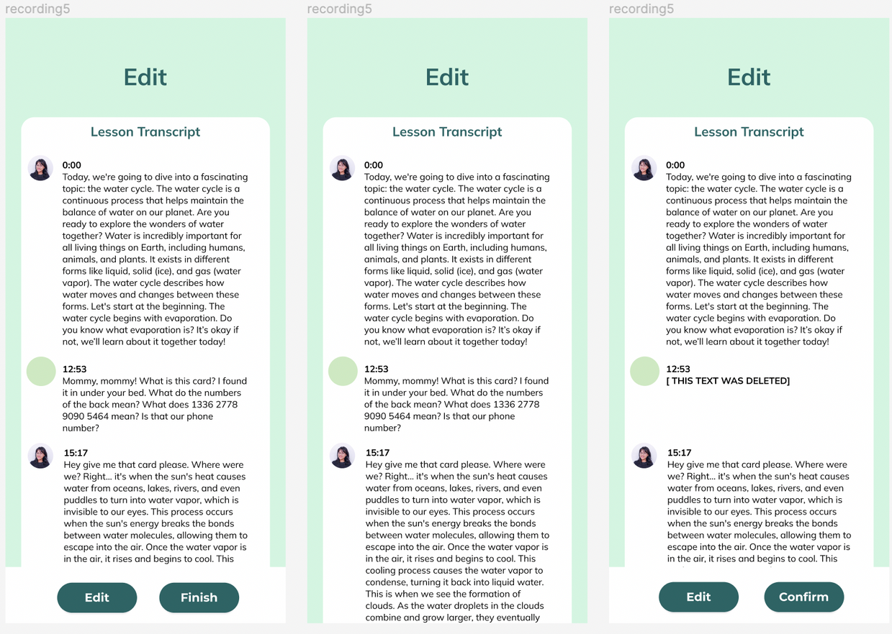
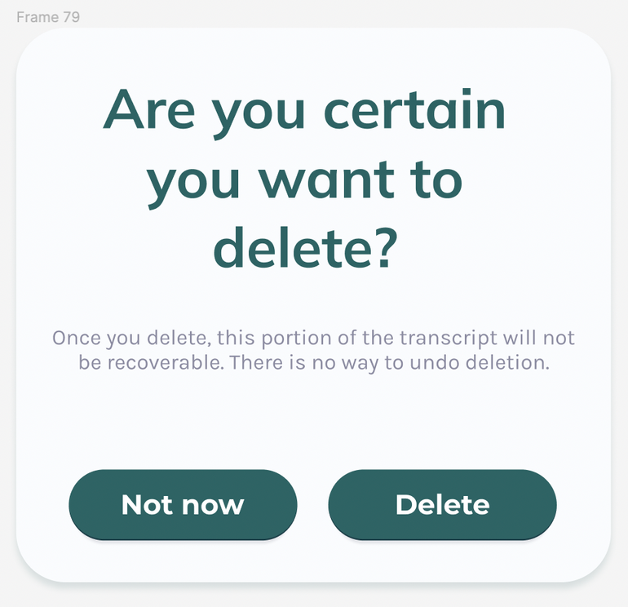
Clarified transcript edit buttons

Slide 10
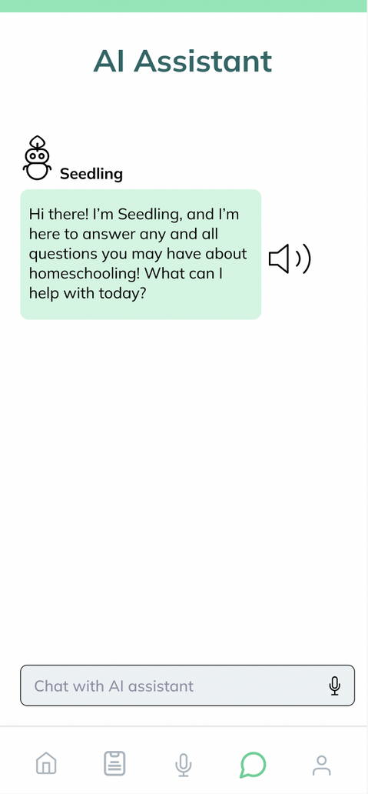
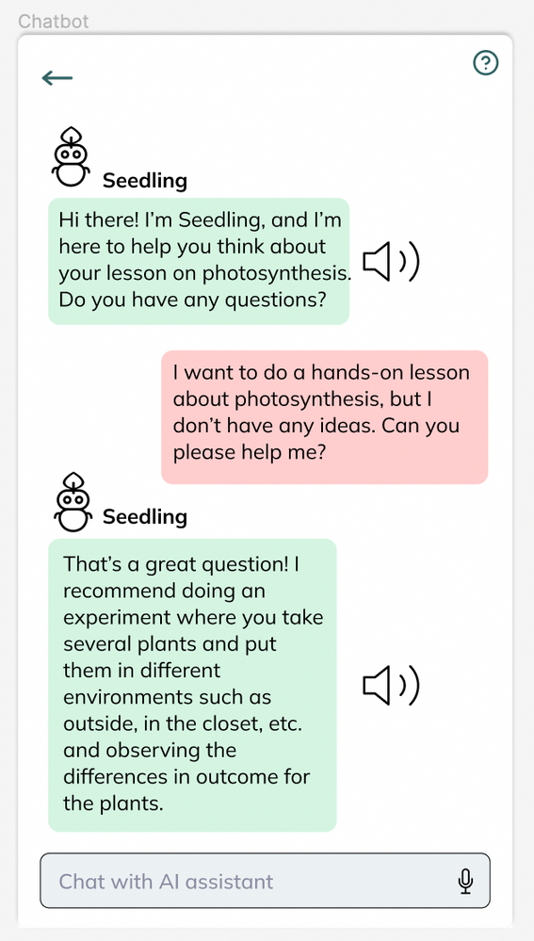
Accessibility: Text-to-Speech functionality

Slide 11
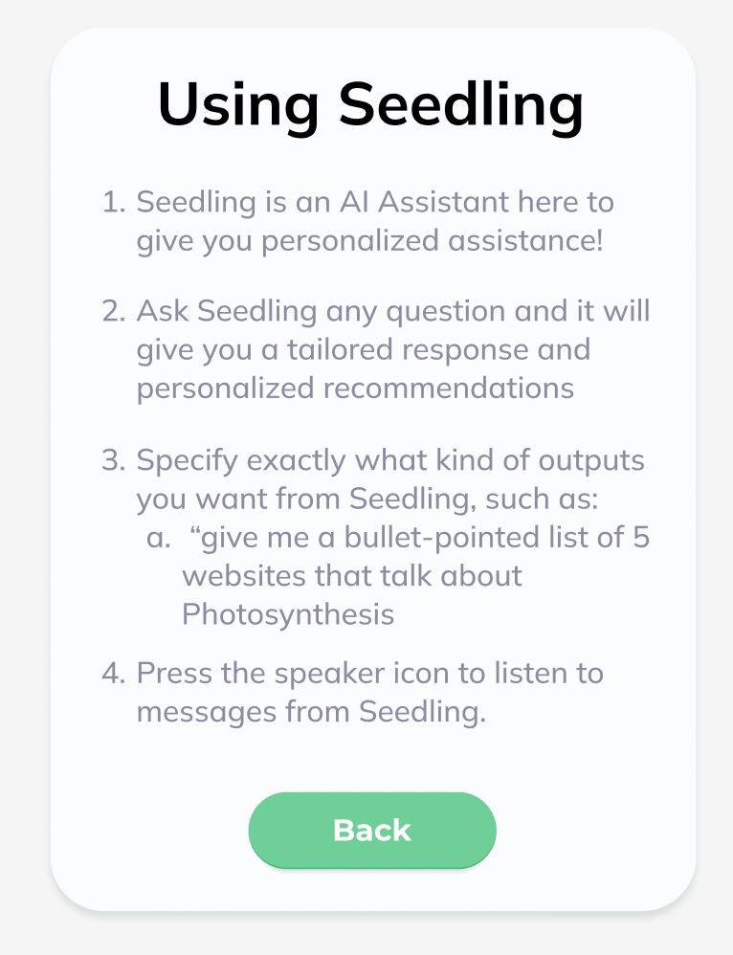
AI Assistant
information page

Slide 12
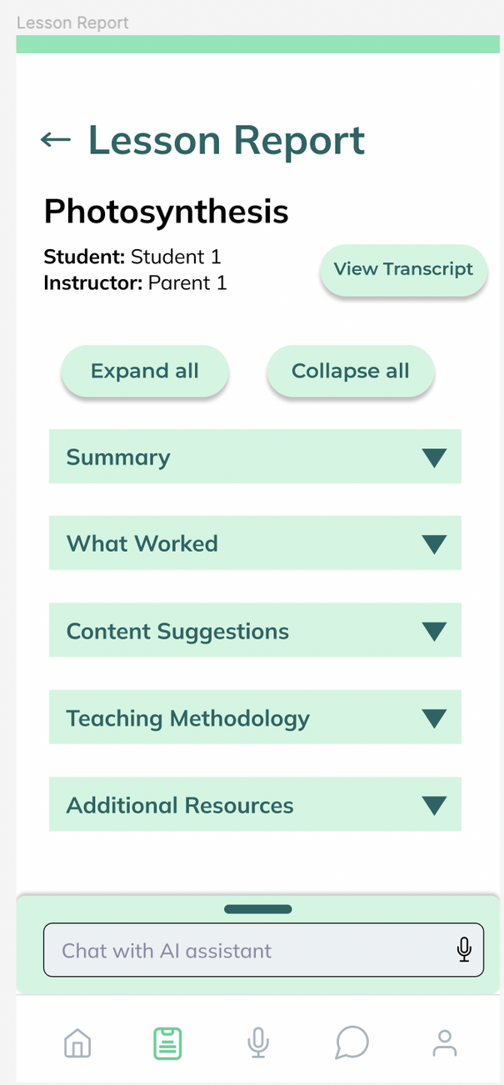
Lesson transcript in report

Slide 13
User Testing

Slide 14


Participants
Homeschooling parent
Software Manager
No education background
2 kids currently homeschooling
Personal network
Virtual Interview
Ex-homeschooled student
Volunteer Coordinator
Homeschooled K-6
Personal network
In-person interview
Ex-homeschooled student
Current student
Homeschooled K-12
Personal network
In-person interview
(Rescheduled)

Slide 15

Tasks
Evaluating UI/UX and functionality
Task 1: Save tip and engage with content
Task 2: Record a lesson, edit a transcript, and upload
Task 3: Find a filtered lesson report and engage with the content
Task 4: Engage and ask questions to the AI assistant

Slide 16
Results &
Future Plans

Slide 17

Key Takeaways
Including encouragement and motivation is critical
Information overload
Tip of day
Lesson report
Non-text information helpful
Answering open-ended questions in report
What's next?
What did we miss?
Lesson recording difficult for some homeschooling styles
"It’s helping with the open-endedness of teaching and helping catch things parents miss and things to go back to." - P1

Slide 18
Planned Design Changes
Tip pages
Increased encouragement
Fewer words (information hierarchy)
Recording pages
Allow for editing transcript (not just deletion)
Lesson report pages
Emphasize affirmation
Consider non-text info (images, diagrams)
AI assistant chat
More example prompts
Change bottom navigation bar
Remove profile page - redundant information

Slide 19
Questions & Concerns
Tailor the tone and types of feedback?
Critical for user retention
Platform frictionless for varying technical literacy?
AI hallucination and novelty dissuade users?
Should we narrow user scope or cater broadly?
Formal lessons vs informal education
How to create useful and affirming notifications?

Slide 20
Thank you!
Questions? Comments?

Slide 21
Appendix

Slide 22
Figma prototype:
https://www.figma.com/file/oCOuGJZPxVFXkWoMFWCuvR/CS377E?type=design&node-id=872-13207&t=fEW0vvAIsy8GjrcO-0

